Slide 1
SAP FINANCIALS SAP Data Migration Overview

Slide 2
COURSE OBJECTIVE
To understand what is SAP Data Migration?
Why we do SAP Data Migration?
What is the role of functional consultant during SAP Data Migration?
How to use S/4 Hana Migration Cockpit

Slide 3
COURSE CONTENT
SAP Data Migration Introduction
SAP Data Migration – How To?
How to write SAP Data Migration Functional Specification
Tools used in SAP Data Migration

Slide 4
SAP Data Migration Introduction
Data migration is a process of moving data from one computer storage type to other storage types.
Data migration is not only moving data between two systems, but it also ensures that moving data should be of high quality, fit-to-use, consistent, is not redundant and can be used properly in target business processes to achieve organizational goals.
In a new implementation of S/4HANA system, data is migrated from SAP system/Non-SAP system to HANA system.
S/4HANA provides comprehensive migration solutions with no programming requirement by the customer, automated mapping of data between source and target system, predefined templates, easily integrated custom objects, reduce test effort and minimize downtime.
Following are different options available for data migration in SAP S/4HANA on premises:
S/4HANA Migration Cockpit with Migration object modeler
SAP DATA Services (SAP DS)
SAP Rapid Data Migration Content

Slide 5
COURSE CONTENT
SAP Data Migration Introduction
SAP Data Migration – How To?
How to write SAP Data Migration Functional Specification
Tools used in SAP Data Migration

Slide 6
SAP Data Migration – How To?
Migration Project
Migration Object
Template
Staging Table
It contains list and
details of all
Mandatory, optional
Fields for migration
object
Upload data can be
view and edit here
Validate Data
Data Mapping
Upload data From template to A staging table
Activate And transfer Uploaded data To the target system
Simulate Data
Load Data
Fill Data in this
Template using .XML file from source system
Hana
Database

Slide 7
SAP Data Migration – How To?
S/4HANA Migration Cockpit (MC)
S/4HANA migration cockpit is an automated migration tool provided with preconfigured content and mapping for each migration object.
For all major functional areas like product, customer, bank, profit centre, cost centre, plant, GL etc, migration objects are predefined and their sequence and dependency is also defined.
Each migration object contains its own predefined template in which source data is uploaded. Automatic mapping is done in source and target structures using the template.
Migration programs are automatically generated for validating data, simulating data and loading into the target system.
To access MC on-premise system, use transaction LTMC. It will open MC on a new web browser.

Slide 8
COURSE CONTENT
SAP Data Migration Introduction
SAP Data Migration – How To?
How to write SAP Data Migration Functional Specification
Tools used in SAP Data Migration

Slide 9
Key Features of Migration Cockpit
This tool is embedded and delivered with S/4HANA system.
No programming is required by the customer.
This tool is used to migrate data from SAP or Non SAP system to S/4HANA.
This tool has a predefined migration object which contains a mapping for all master/transactional data. It reduces migration cost and time.
Migration activities are predefined and easy to use.

Slide 10
SAP Data Migration Functional Specification
How should we write a typical Data Migration Functional Specification?
Identify the transaction for which data need to be migrated.
Identify the transaction(s) in R/3 via which you want to import the data into your SAP system. It may be relevant whether you need the data for statistical analysis or for further processing in the system.
Run the relevant transaction in R/3 manually with test data from the legacy system and see which fields must be filled. There may be required fields that do not correspond to data fields in the legacy system. In such a case, you should better assign a fixed value or establish an optional field for data transfer.
Map the fields in advance in written form: Assign the source fields to the target fields.
Determine the form in which non-SAP data will be transferred into the SAP system (e.g. via "Move" or according to a rule).

Slide 11
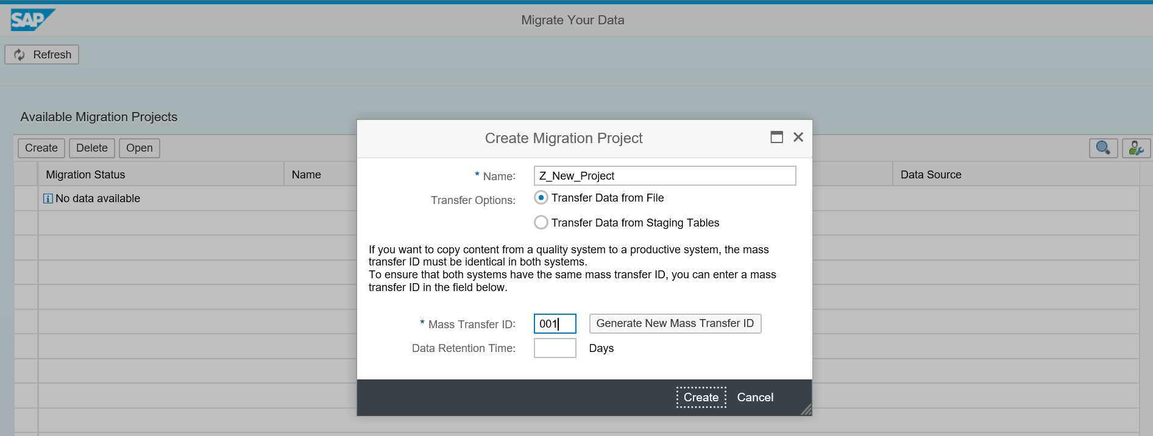
Steps to Migrate data using MC
I. Migration Project: First step is to create or open migration project in MC. Migration project facilitates the transfer of data from the source system to S/4HANA system and monitors migration status. The migration project is always associated with ‘Transfer ID’. This transfer id is a unique identifier, which facilitates the transfer of projects between different systems of the landscape. For example, if the migration project is transferred from quality to the production system, then project transfer id should be the same in both systems.Use Transaction Code:LTMC.
It will take to web browser screen where below displayed screen will appear.
Below is screenshot where a new project Z_NEW_PROJECT is created with transfer id 001 and default view is On premise.

Slide 12
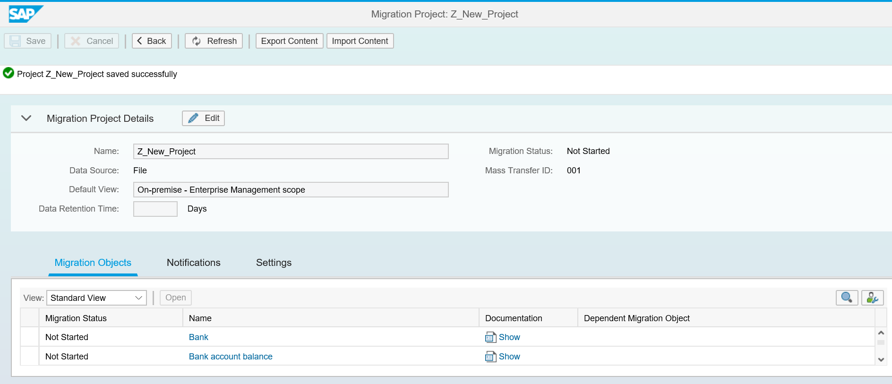
Steps to Migrate data using MC
II. Migration object : Once migration project has been created, then migration object has to be chosen. Migration objects are predefined and provided by the SAP system.
Below is a screenshot of migration object available on a migration project.

Slide 13
Steps to Migrate data using MC
Migration object comes with the following information:
Status — object can be Not started, Finished or In-Process.
Object name — it is migration object name which is relevant to customer master or transactional data.
Documentation — It provides all information on migration object like required structure, fields, uses etc.
Dependent migration object — It shows a list of migration objects that must be loaded first or already present in the system. For example, before loading material master, profit centre object data must be loaded or should exist in a system.

Slide 14
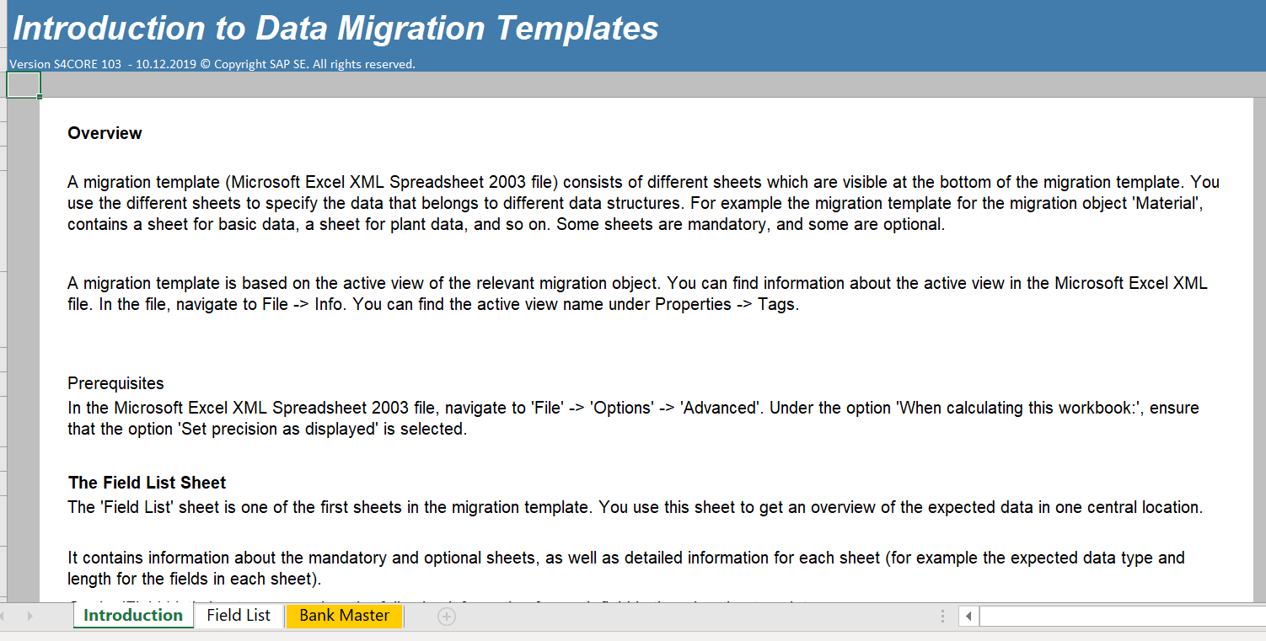
Steps to Migrate data using MC
After selecting migration object we need to execute the following steps:
Download Template- When download template is clicked for the 1st time, the system will copy object template into migration project. This template will provide the list for fields which should be filled for data transfer. A template is downloaded in excel format. If .xml is not given, then save file with .xml. Template fields, type, length should not be changed and always use paste ‘V’ option for copying data in the template. Once a template is copied into the project, then any changes to a template by SAP do not reflect in that project’s template
First sheet is always a field list which contains information about mandatory/optional fields, field length, type etc. Here we can see one file (basic data) is in orange color, it means this is a mandatory sheet in which we have to provide data. Others sheets are optional.

Slide 15
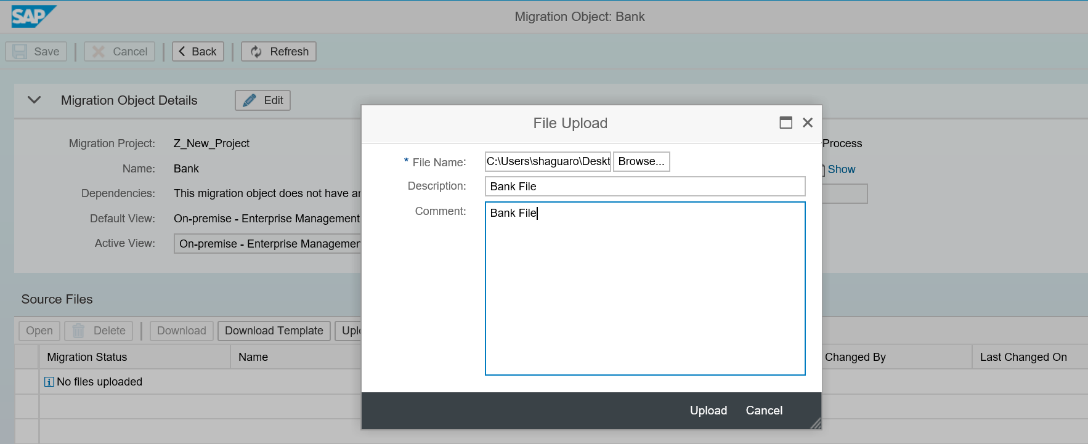

Steps to Migrate data using MC
Upload file — Legacy data can be filled into the downloaded template. It can then be uploaded as a .XML file in MC for migration. More than one file can also be uploaded.

Slide 16
Steps to Migrate data using MC
View and Edit- Once a file has been uploaded, data can be viewed by clicking on the name of a file. If required, data can be edited in the file by clicking on the edit button.
Activate — Transfer process can be started only for Activated files. File are activated by clicking on Activate button.
Deactivate — In the case of multiple files, if the user doesn’t want to transfer some files, then they can choose the file/s and deactivate them. File with active status can be transferred.
Start Transfer — Data transfer for active files can be started by clicking on the ‘Start Transfer’ button

Slide 17
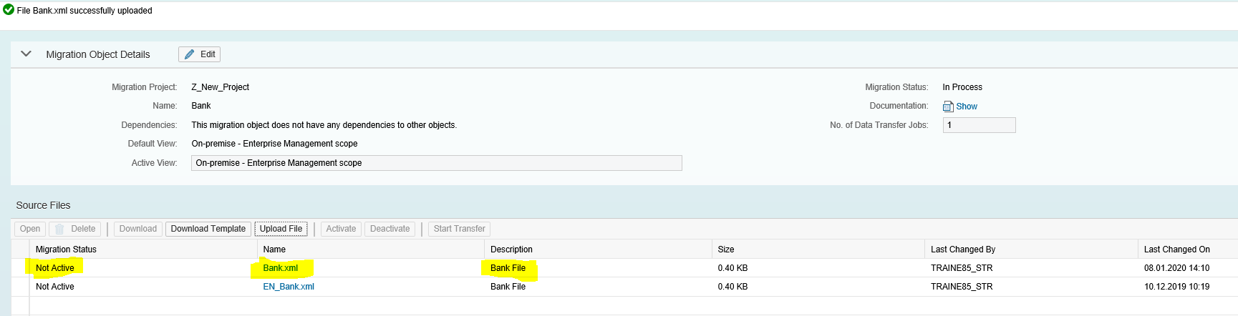
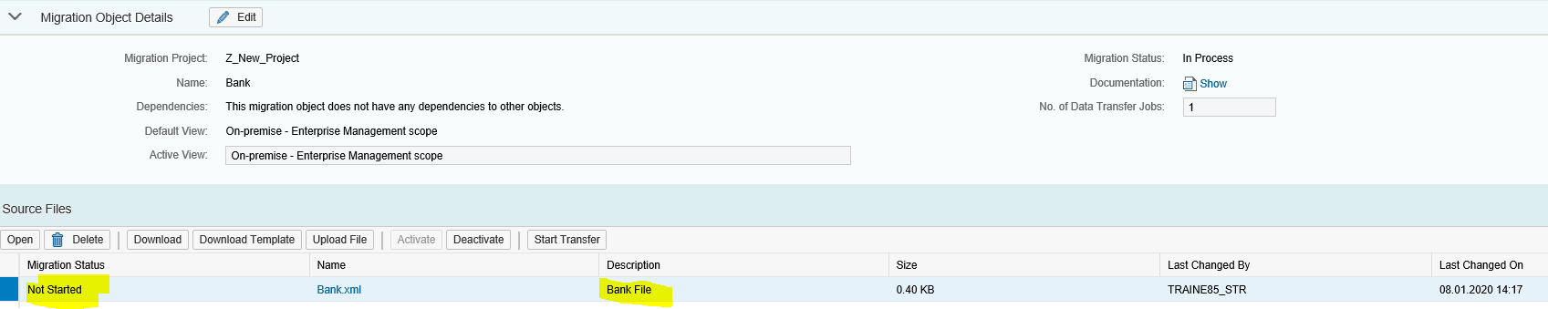
Steps to Migrate data using MC
The task item is created once the upload is done.
Select the task item and Click on Activate icon

Slide 18
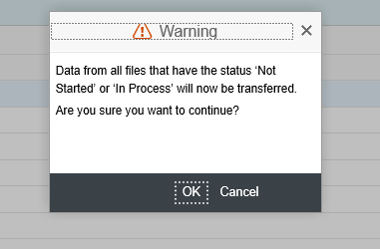
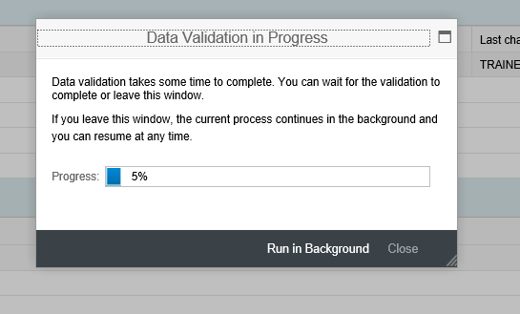
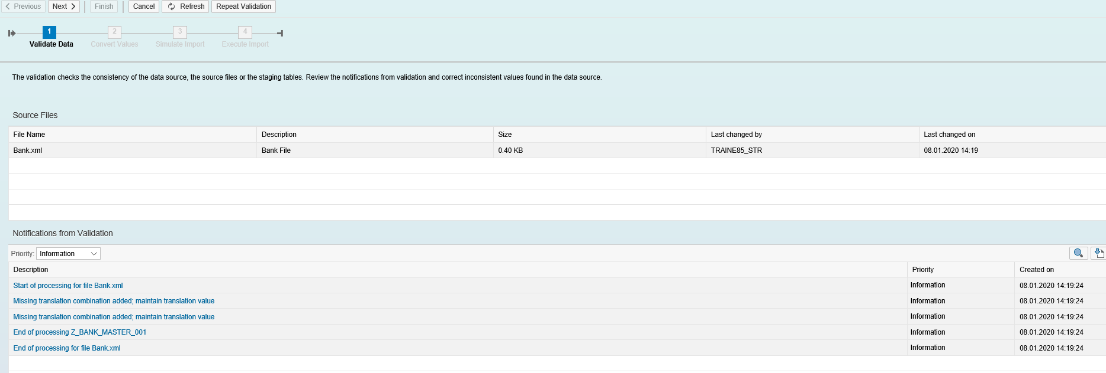
Steps to Migrate data using MC
Click on Start transfer icon
It can be seen that data will first get validated and then converted.

Slide 19
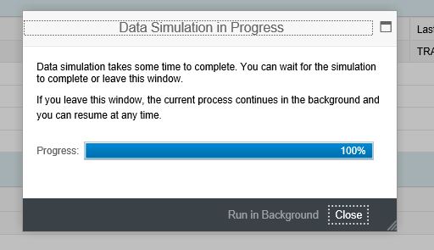
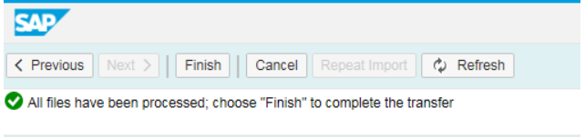
Steps to Migrate data using MC
Once the upload is successful, we need to click on next.
Click on Next for update run

Slide 20
Steps to Migrate data using MC
Following steps have to executed after starting the transfer of data:
Data Validation- Data stored in the staging area is checked against the mandatory field, type, length.
Value conversion- Mapping rules can be defined between the source and target system. For example country code ‘USA’ is set in the source system but in the target system it should be mapped to ‘US’.
Simulation- Data stored in the staging area is processed by actual BAPI’s but commit is not performed. Warning and error messages are displayed here for data correction.
Execution/finish- In this step, data is actually posted to SAP S/4HANA system using relevant BAPI.
After executing all above steps, press FINISH button to commit changes in the database.
After execution it shows status as Finished.
In case of errors, error records need to be corrected and then the corrected file will have to go thru the above process. MC supports only insert statement.

Slide 21
Migration Cockpit Advantages
The main advantages of the S/4 Hana Migration Cockpit:
Faster overall process (export/import), less clicks
Performance
Use Database Tools to Extract and Transform
Standard XML template provided by SAP for each migration object and can be customized according to requirements.
User friendly and predefined process, with validation and simulation in place .
Useful for Master Data Migrations, open item migration, balance migrations, Asset migrations, etc.
Preconfigured Business Objects
Errors can be corrected on the fly.

